Slide 1
COVID19 Visualisation and Prediction using Tableau and Python
Project coordinator: Dr Chris Mayhew
Project Supervisor: Michael Thompson
Submitted By:
Ishan Bhatt
(180006050)

Slide 2
Aim of the project
The major aim of this project is to know the basic statistic of covid-19, visualize different graphs, and predict future confirmed cases. From this visualization any people can understand the statistics easily even medical staff and non-technical person easily understand the graphs. However, the major challenge is to process various data based on requirements and made interactive dashboard.

Slide 3


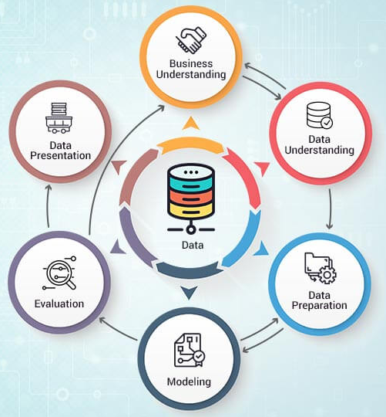



Methodology
Figure 1:CRISP-DM Methodology (Analytics and business intelligence – The knowledge factory. (n.d.). The Knowledge Factory – Learn – Share – Care.)

Slide 4
Data description
Dataset 1
Feature | Description
ID | Identification number
Age | Age of patient
Sex | Gender
City | City
Province | Province
Country | Country
Wuhan or not | Travel from Wuhan or not 0 means Wuhan and 1 means not Wuhan
Latitude | Geo location
Longitude | Geo location
Symptoms | Symptoms detected in COVID-19 test
Lives in Wuhan | Stay in Wuhan or not
Travel history | Travel location
Additional Information | Such as contacted with positive case, arrived date and location
Admin1 | Which contains district based on geo location
Admin2 | Which contains district based on geo location
Admin3 | Which contains district based on geo location
Geo resolution | Admin1, Admin2, Admin3
Dataset 2
Feature | Description
Province/State | Province and state
Country/Region | Country and region
Lat | Geo location
Long | Geo location
Dates: 1/22/20 – 4/17/20 | This data has been updated daily. So, latest date varies.

Slide 5

Data Modeling for prediction
build prediction model in python
SVM prediction
Polynomial regression

Slide 6
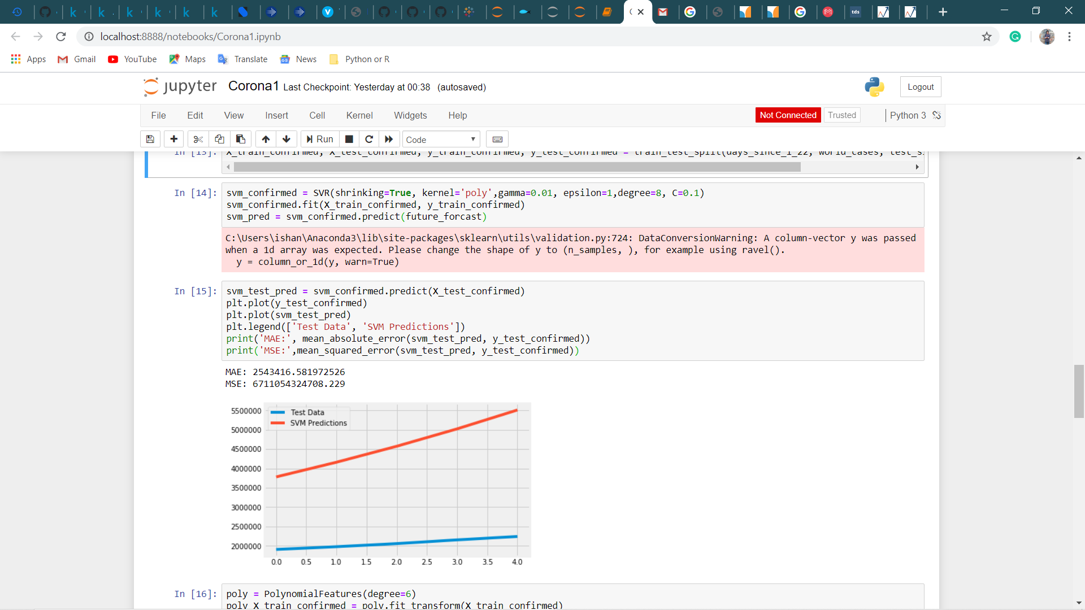
SVM Prediction
Support vector Machine (SVM) is one of the popular algorithms which is known as supervised machine learning techniques.

Slide 7
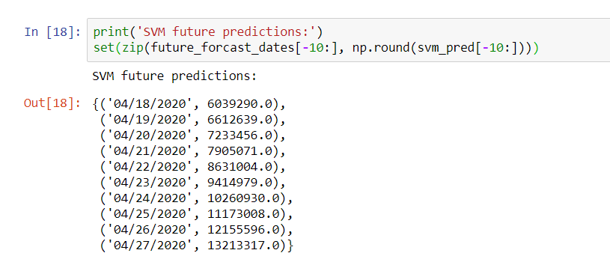
Output of SVM

Slide 8
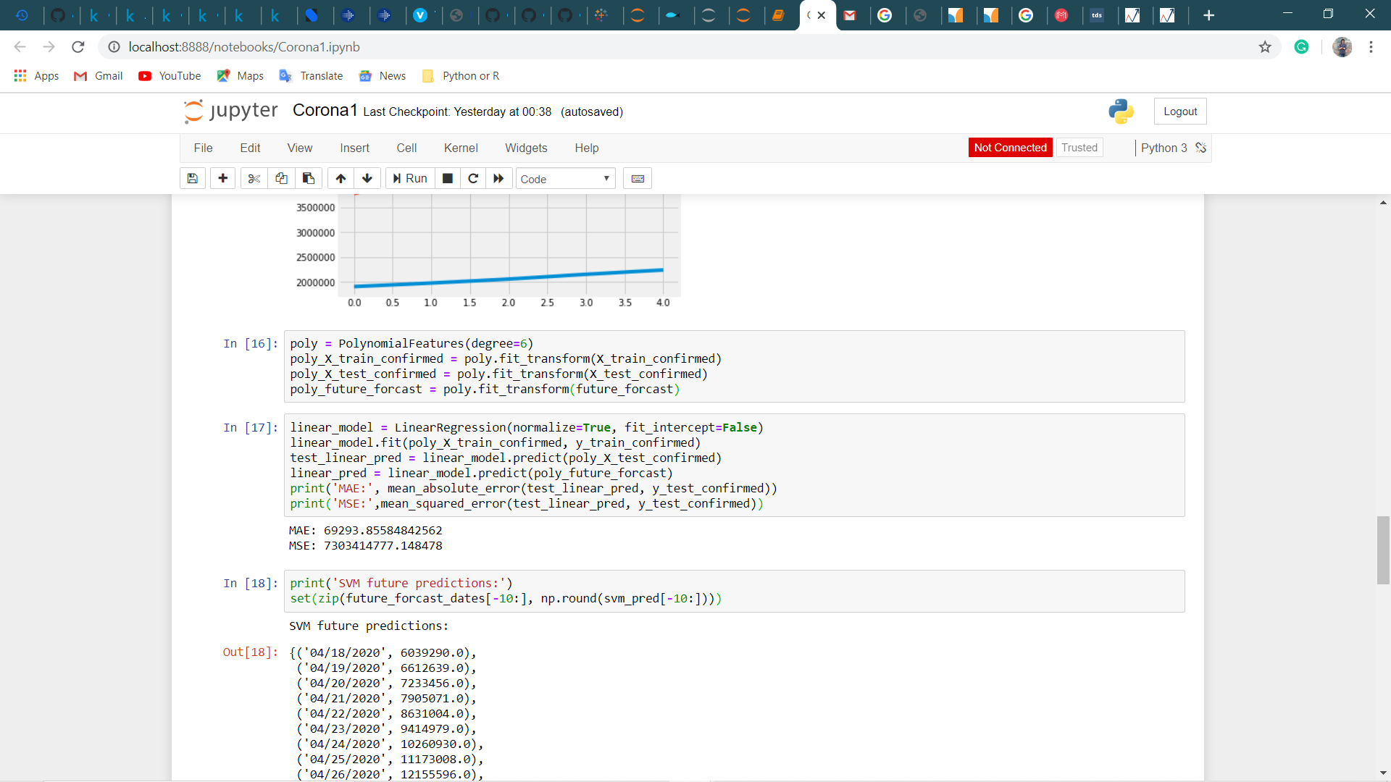
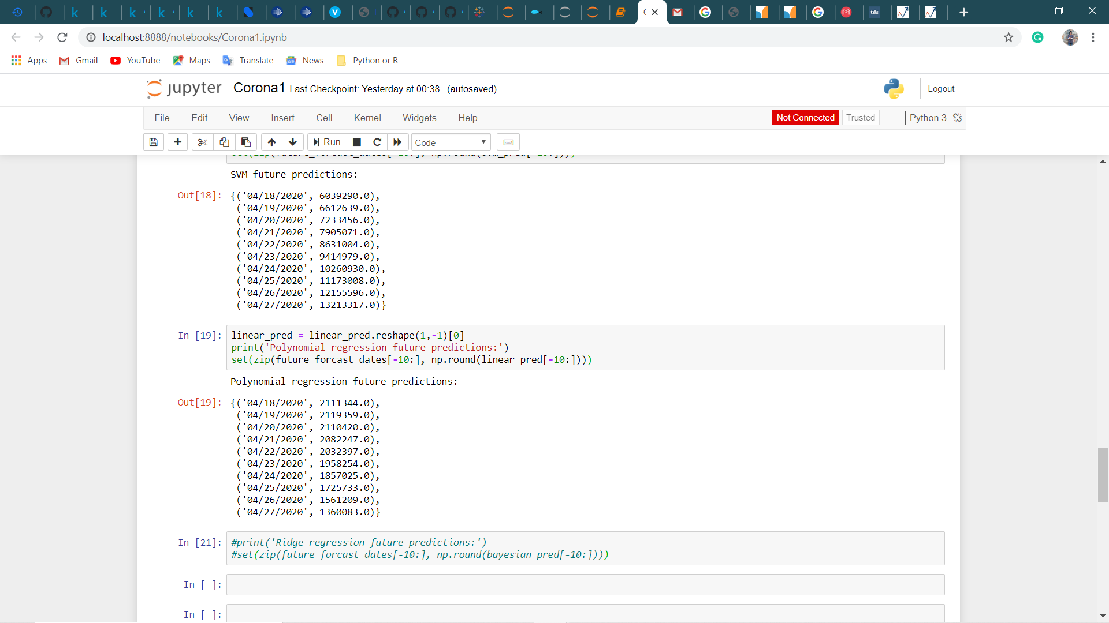
Polynomial Regression Model
The first figure shows the MAE and MSE, if it is too low than its consider as an overfitted data, however, it is totally depends on the data.
Timeseries data requires the reshape as we do not know the dimension and axis of the data. This picture shows the results of the next predicted confirm cases.

Slide 9
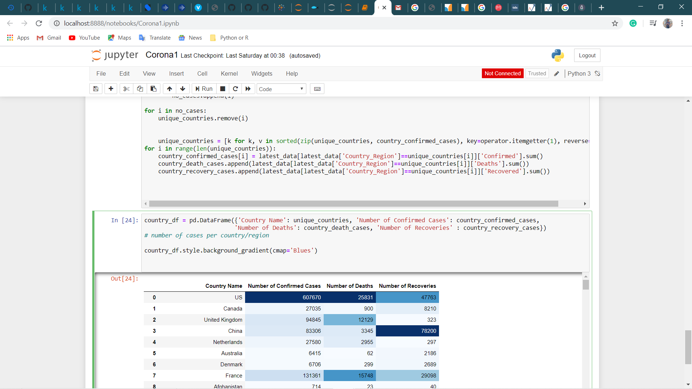
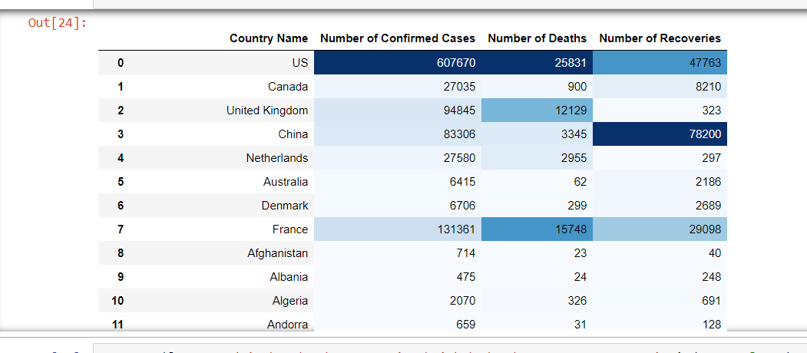
Gathering all data of cases

Slide 10
Tableau
Visualizations

Slide 11
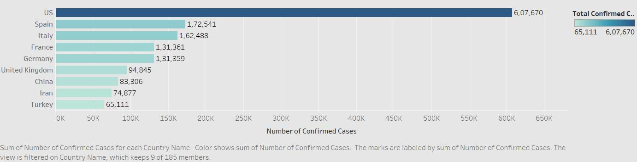
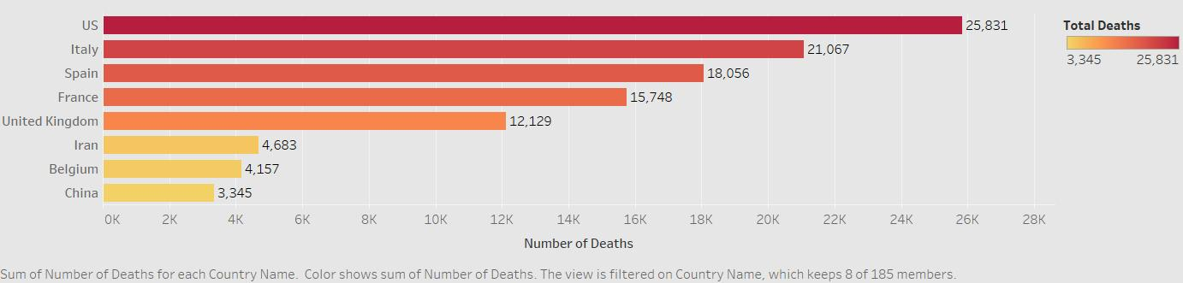
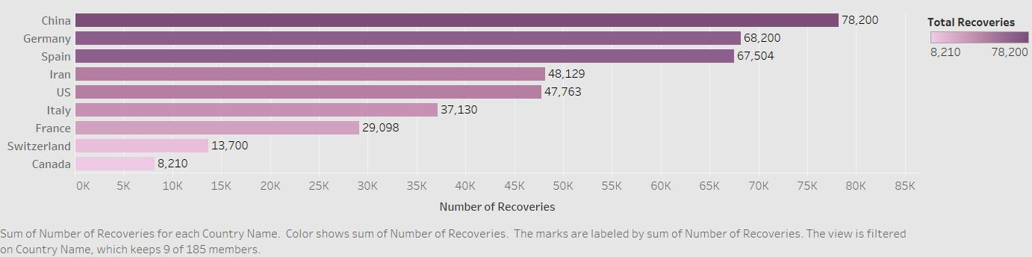
Analysis 1

Slide 12
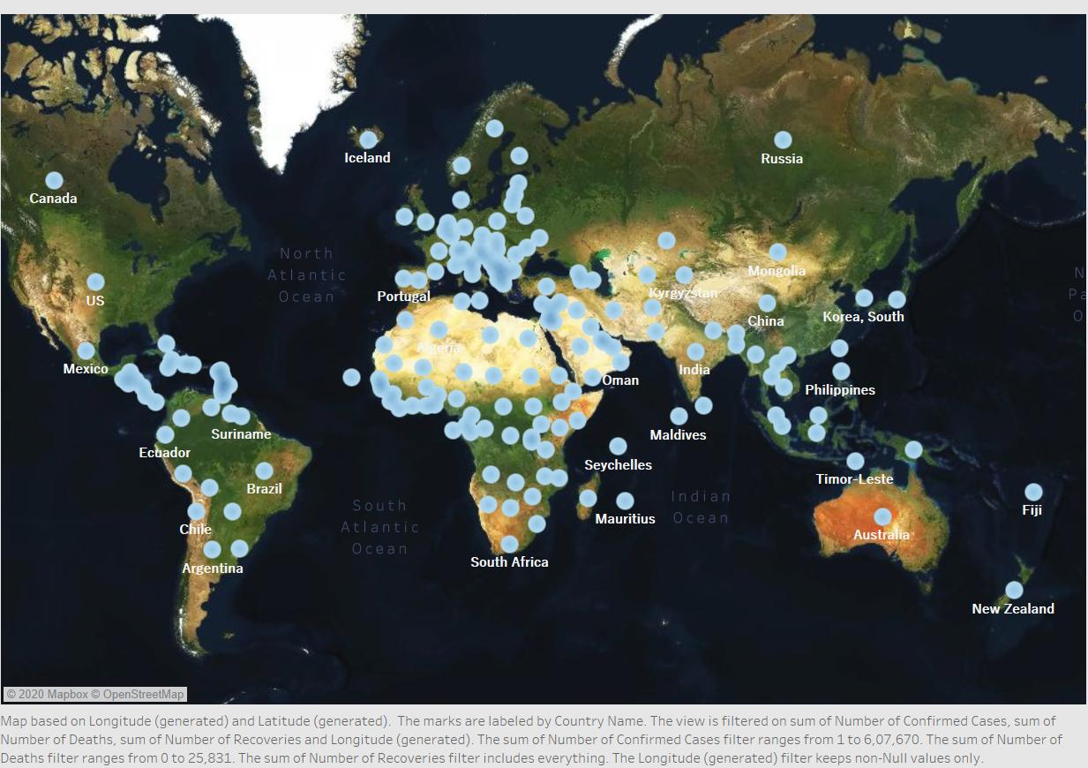
World Map

Slide 13
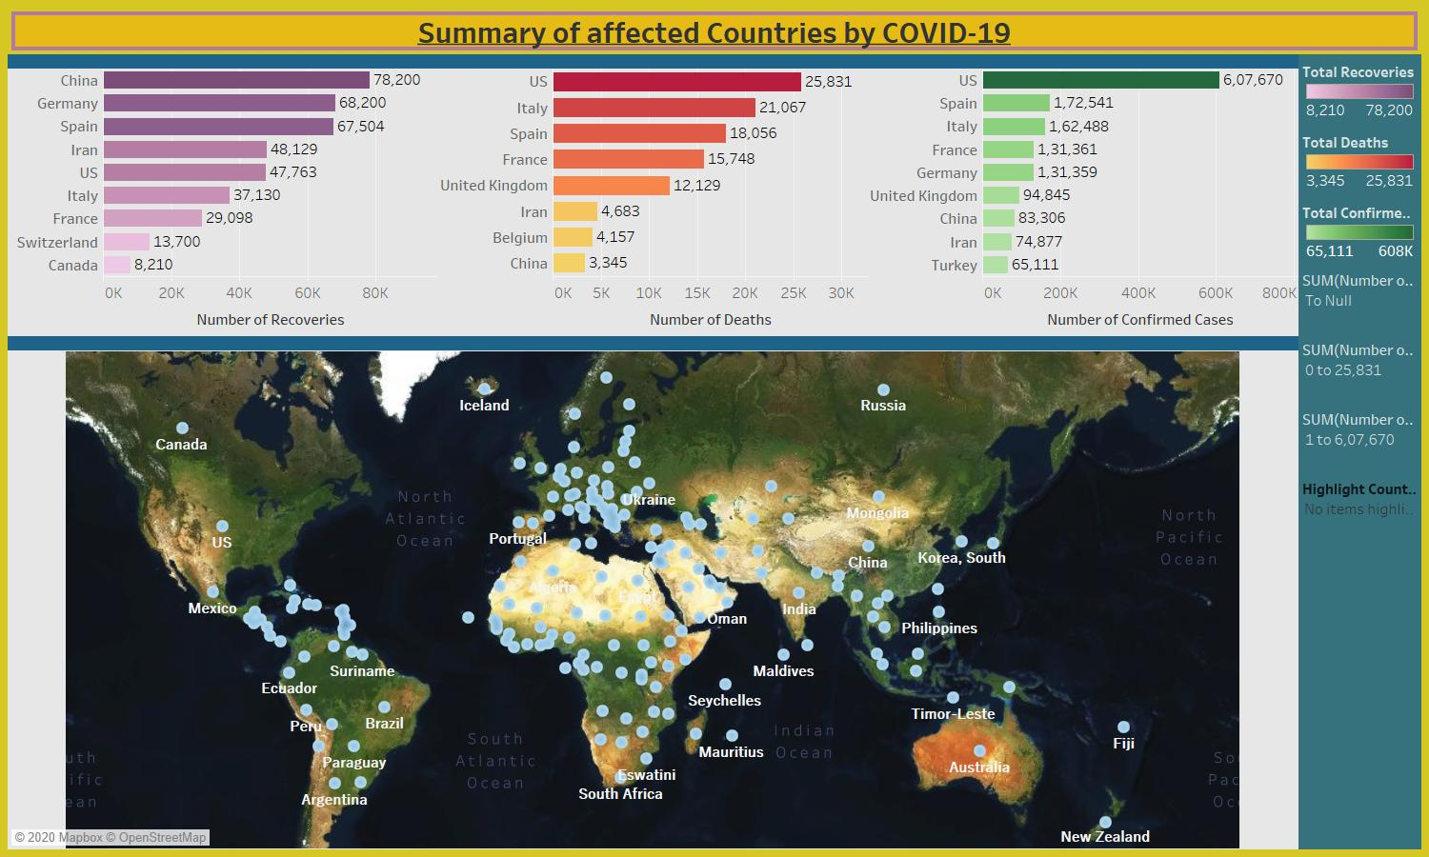
Dashboard1

Slide 14
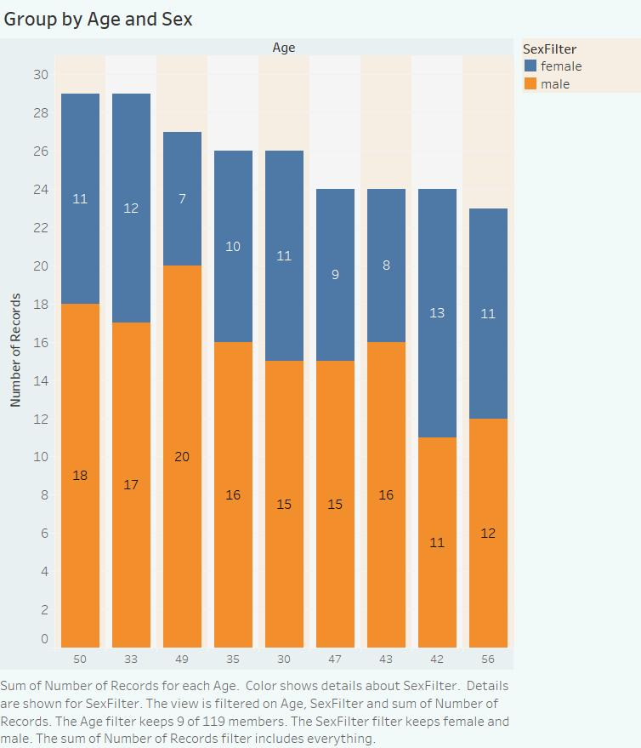
Analysis 2

Slide 15
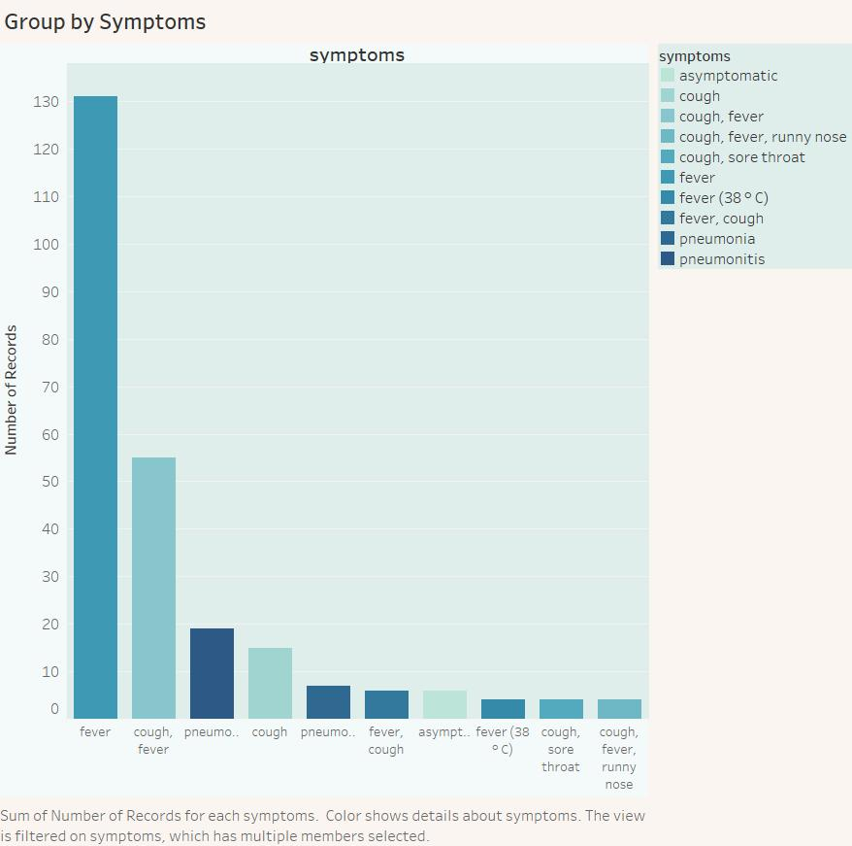

Slide 16
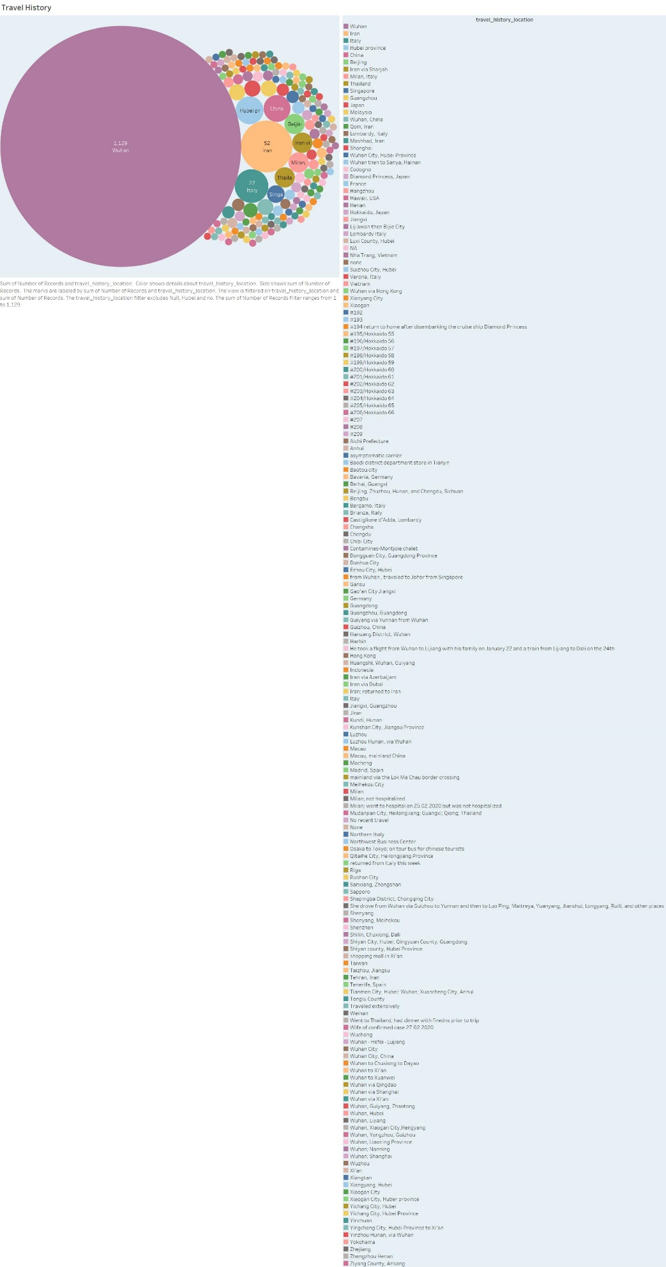

Slide 17
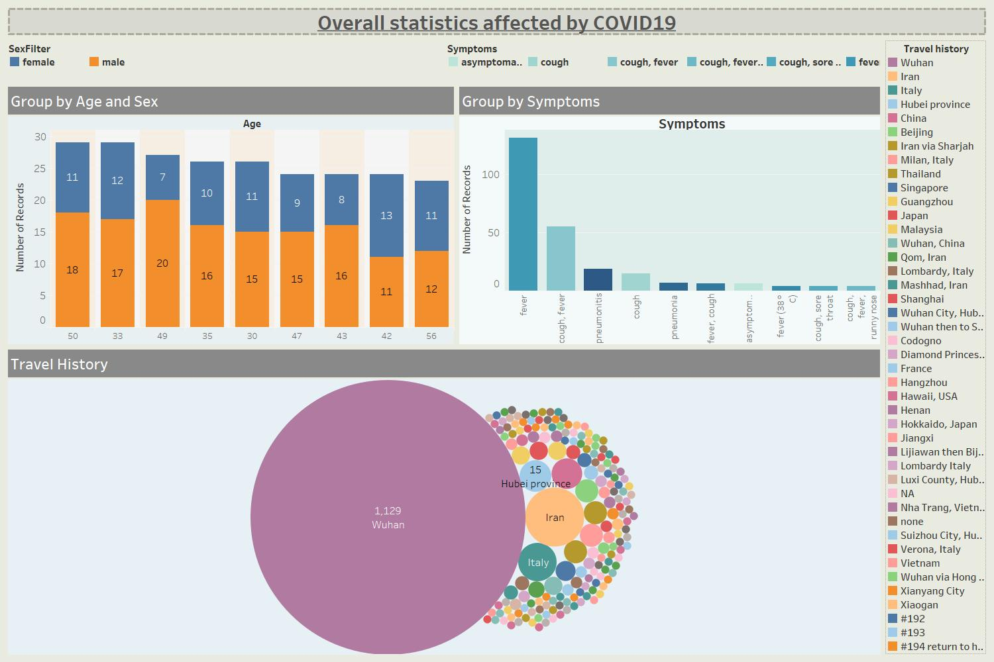
Dashboard 2

Slide 18
Different phases of project
Phase | Summary of Phase | Key Deliverables
Requirements of tools for project | Installing resources to create environment. Install Visualization tool - Tableau Install Anaconda 3 for python | Python coding and Tableau visualization
Execution | Preprocessing of data Prediction Regression model Gathered all data for better understanding | Analysis in python Collect data from multiple sources
Outcome | create best prediction algorithms create dashboards for ease understanding | Made two dashboards Predict future confirm cases in python

Slide 19
Upgrade my Skills for the Project
Tableau
Python coding

Slide 20
List of the problem
Problems while installing software
Looking for perfect IDE to work in python
Find difficulty to deal with multiple
Difficulty in python coding
Dealing with removing null values and filtration in data
Load multiple data in tableau for data insights
Dealing with tableau for perfect visualization and create dashboards

Slide 21

Conclusion
By putting all the efforts, I successfully able to analyze, predict and visualize covvid-19 data. This summary of the data and prediction absolutely meets standard business needs. I create interactive tableau dashboards; in which every user can understand easily including non-technical person. In python environment I use polynomial regression and SVM prediction machine learning techniques to predict future confirm cases. However, this can be improved by changing some coding to make better model. I can also predict future deaths and recoveries by simple modification in code; but I don’t want any complexity in project. At the end I gathered data from multiple sources to count total number of cases – confirmed, deaths, and recoveries group by countries to make dashboards in tableau for advance analytics. In next version, I can also predict future deaths and recoveries in python and make interactive web app for visualization; so that anyone can able to see data insights and impact on covid-19 to the different countries.

